Slide 1
Andrew Frost– Business Development Manager
Notes:
A little bit about me, and my role.

Slide 2
Who are ?
Introduction
Risk & Opportunity
Currency Risk Management
Adapting to change
What can moneycorp do?
Core benefits of moneycorp
Notes:
We are a global currency and international payment specialist, focussing 100% on everything involved in foreign exchange
Introduction – commercial partnership with Clarkson Hyde to provide FX as an additional service to their clients. Operate as an external FX consultant to ensure their clients are managing FX cost effectively enough.

Slide 3
About Moneycorp
FCA Authorised and Regulated
TTT Moneycorp Limited is authorised and regulated by the Financial Conduct Authority for the provision of payment services.
1962
Company incorporated
1979
Started dealing in foreign exchange
5A 1
Strongest security rating in the industry with D&B
One stop shop
Corporate, Private, Wholesale, Retail
7.1m+
Customers transactions last year
£33+ bln
Traded in currencies last year
Preferred partner
ICAEW, Telegraph, The Guardian,
BCC, CNN, The Post Office,
The City AM, UKTI, The FT, ABTOI

Slide 4
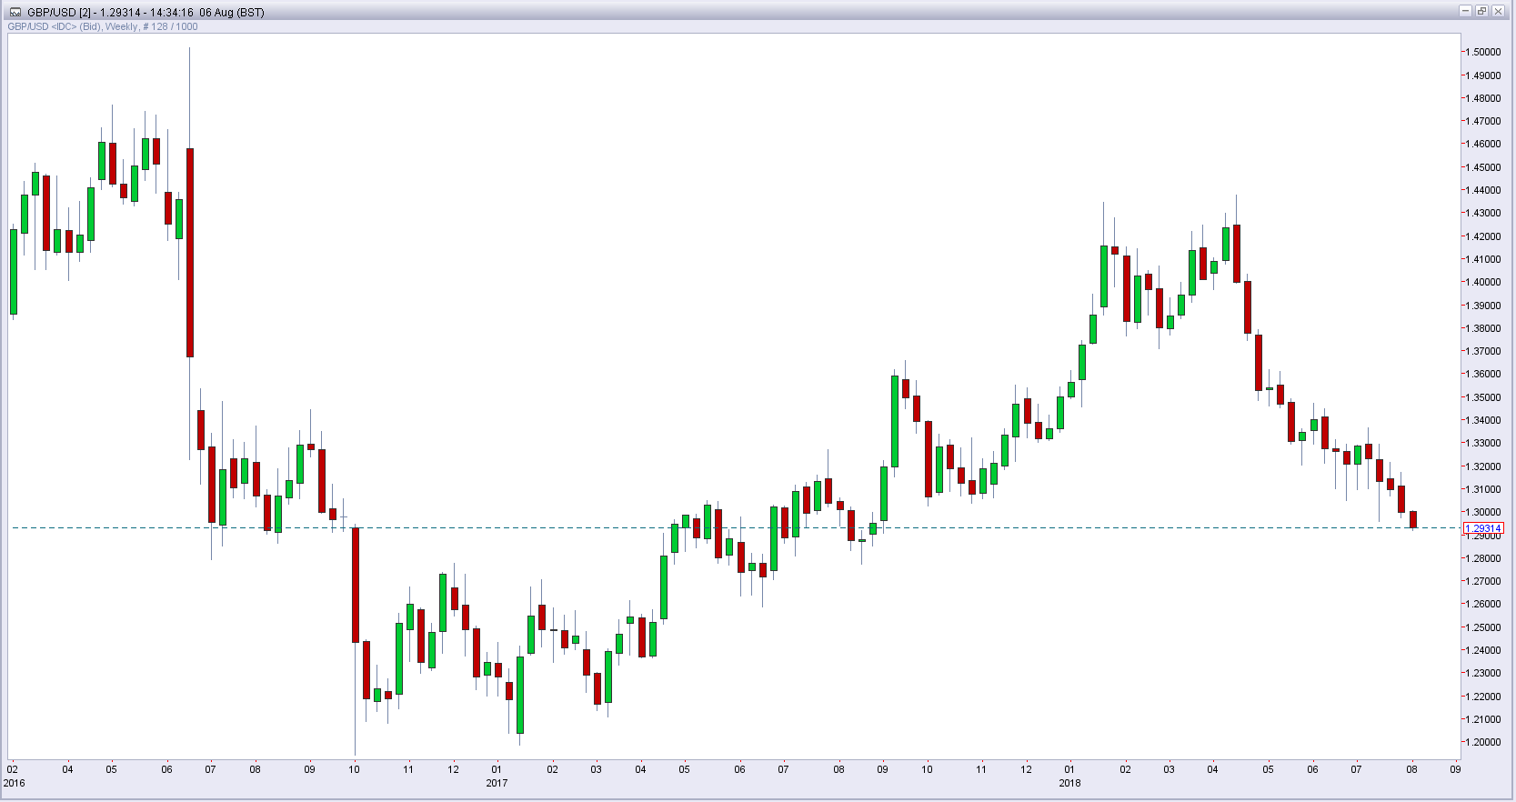
Brexit – Risk or Opportunity
Notes:
Shows the Brexit Impact on GBP USD 6/8/18
With everything there are 2 sides to an argument for our importers and exporters
Clearly with the devaluing pound our export market would grow however import businesses would suffer and profits be squeezed if proper risk management strategies were not used.
This is where we come in
Shows the Brexit Impact on GBP USD 6/8/18
With everything there are 2 sides to an argument for our importers and exporters
Clearly with the devaluing pound our export market would grow however import businesses would suffer and profits be squeezed if proper risk management strategies were not used.
This is where we come in
Profitability
Pricing
Import Costs
Employment
Expansion
New markets
Export growth

Slide 5
Brexit – Risk or Opportunity
What is currency risk management
Currency risk comes from the impact of market movements on the cost of exchange from one currency to another
The most common type of currency risk we see is transactional risk
This is the risk associated to a companies cross border transactions, often there is a time delay between receiving invoice in a foreign currency and settlement of the invoice, in some industries this can be as long as 90 days
If during this period their home currency devalues against the foreign currency, this will lead to a rise in price of the goods.
Our role is to provide access to products to remove this uncertainty and risk and give a level of certainty and security.
For the standard SME/Mid Cap corporate the full range of products spot, forward and options are not always available.
Moneycorp allow full access to SME clients to a complete range of risk management tools, giving them the same level of protection as large corporates

Slide 6
All change for accountants
Adapting
Priorities
Advisory
Services
Guidance
Education
Partnership
Approved
Notes:
Adapting - Adapting to change and the needs of clients in a fast moving commercial environment
Advisory - Quickly moving into becoming trusted advisors in a number of areas
Priorities - There are a great deal of pressures on businesses, regulation, data protection etc constant alternative priorities
Services- Creates scope for a larger range of services to be provided by the accountant
Guidance - CFO’s, MD’s, CEO’s looking to outside help to solve issues and often turn to accountant
Education - SMEs can lack the skills and understanding to manage foreign exchange cost effectively
Partnership - We therefore sit alongside in conjunction with accountants, and provide a service they can be proud of
Approved - Therefore clients have a pre approved trustworthy solution with a track record and all background and due dilligence undertaken

Slide 7
Current FX situation in UK
SME
Notes:
Approximately 75% of UK companies still use their bank and never bother to check up on the prices, or look at alternatives
Remaining 25% use a foreign exchange specialist - more competitive rates of exchange and guidance – as that is all we do
Banks offering exchange rates that can be typically up to 2%+ worse
Fees on top of the FX deal are then typically £15-£30 – we will do this free off the back of an FX deal.
As banks are required to increase their capital adequacy in line with Basel III and EU regulation, SME’s will see the deposits required for forward and options contracts start to increase

Slide 8
What can Moneycorp do?
SME
Notes:
Through one account access over 10 liquidity providers and therefore can benefit from our outstanding pricing capabilities
As you can see we work with only tier one providers and due to our collective FX flow they compete over our exposure and therefore we are able to achieve exceptional pricing which can be passed onto our clients

Slide 9
The benefits of partnering with moneycorp
Preferential exchange rates
Dedicated account manager and expert market guidance
Funds safeguarded in segregated client bank accounts
Easy to use, fast online platform 24/7 or can deal via the phone
Multiple currency hold accounts when you open your Moneycorp account
FX products tailored to your needs
Free transfers - no fees or added charges on a single payment off the back of an FX deal

Slide 11
Get In Touch
Andrew Frost
Enterprise Partnerships Business Development.
Telephone Number:
0203 823 0252
Email:
Andrew.frost@moneycorp.com
Claire Berg
Clarkson Hyde Marketing and BD Manager
Email:
clc@clarksonhyde.com

